Slide 1

Introduction to Management
Chapter# 1
Engineering
Management

Slide 2

Difference between a Manager and Management
A Manager is someone who coordinates and oversees the work of other people so that organizational goals and objectives can be accomplished.
Management in all business areas and organizational activities are the acts of getting people together to accomplish desired goals and objectives.
Organizations comprises of people working together and coordinating their actions to achieve specific goals.

Slide 3
Difference between Objectives and Goals
What are Goals?
A goal is a short statement of a desired outcome to be accomplished over a long-time frame, usually three to five years.
It is a broad statement that focuses on the desired results and does not describe the methods used to get the intended outcome.
Some common examples of business goals include the following:
➲ Maximizing profits  Growing revenues
➲ Increasing efficiency  Providing excellent customer service
➲ Becoming an industry leader  Creating a brand
➲ Becoming carbon-neutral

Slide 4
Resources needed by an Organization
Resources
Resources are organizational assets and include:
⋅ People  Machinery  Raw materials
⋅ Information  Skills  Financial capital

Slide 5
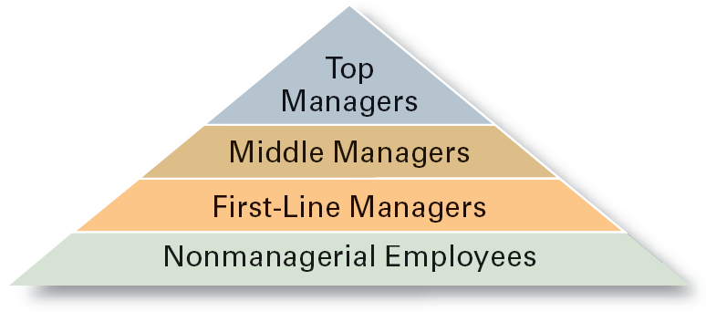
Levels of Management

Slide 6
Classification of Managers
First-line Managers
Individuals who manage the work of non-managerial employees.
Middle Managers
Individuals who manage the work of first-line managers.
Top Managers
Individuals who are responsible for making organization-wide decisions and establishing plans and goals that affect the entire organization.

Slide 7
Managing for Competitive Advantage
Cost Competitiveness
Innovation
Competitive advantage is a position of a company in a competitive landscape that allows the company earning return on investments higher than the cost of investments.
Quality
Speed

Slide 8
Managing for Competitive Advantage
 Cost Competitiveness
costs are kept low enough so that you can realize profits and price your products at levels that are attractive to consumers
key is efficiency - accomplishing goals by using resources wisely and minimizing waste
 Quality
excellence of a product, including its attractiveness, lack of defects, reliability, and long-term durability
importance of quality has increased dramatically
must identify specific elements of quality to correct problems, target needs, and deliver world-class value

Slide 9
Managing for Competitive Advantage
 Speed
often separates winners from losers in world competition
speed became a vital requirement in the 1990s since requirement has increased exponentially
 Innovation
the introduction of new goods and services
important to adapt to changes in consumer demands and to new sources of competition
Best managers and companies delivering all four.

Slide 10
Organizational Performance
Measures how efficiently and effectively managers use resources to satisfy customers and achieve goals.
 Efficiency
A measure of how well resources are used to achieve a goal.
Usually, managers must try to minimize the input of resources to attain the same goal.
 Effectiveness
A measure of the appropriateness of the goals chosen (are these the right goals?), and the degree to which they are achieved.
Organizations are more effective when managers choose the correct goals and then achieve them.

Slide 11
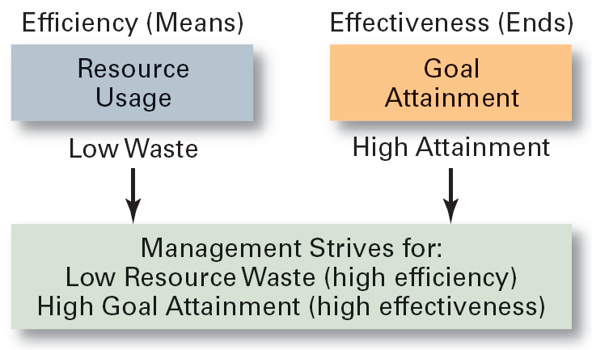
Efficiency and Effectiveness

Slide 12
Managerial Functions
Planning
Defining goals, establishing strategies to achieve goals, developing plans to integrate and coordinate activities.
Organizing
Arranging and structuring work to accomplish organizational goals.
Leading
Working with and through people to accomplish goals.
Controlling
Monitoring, comparing, and correcting work.

Slide 13
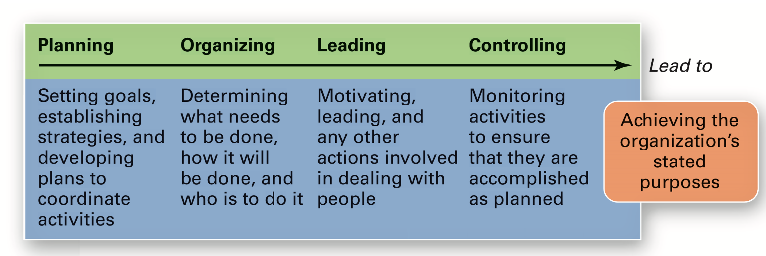
Managerial Functions

Slide 14
Managerial Functions
⋅ Planning
Planning is the process used by managers to identify and select appropriate goals and courses of action for an organization.
3 steps to good planning
1. Which goals should be pursued?
2. How should the goal be attained?
3. How should resources be allocated?
The planning function determines how effective and efficient the organization is and determines the strategy of the organization.

Slide 15
Managerial Functions
⋅ Organizing
In organizing, managers create the structure of working relationships between organizational members that best allows them to work together and achieve goals.
Managers will group people into departments according to the tasks performed.
Managers will also lay out lines of authority and responsibility for members.
An organizational structure is the outcome of organizing. This structure coordinates and motivates employees so that they work together to achieve goals.

Slide 16
Managerial Functions
⋅ Leading
In leading, managers determine direction, state a clear vision for employees to follow, and help employees understand the role they play in attaining goals.
Leadership involves a manager using power, influence, vision, persuasion, and communication skills.
The outcome of the leading function is a high level of motivation and commitment from employees to the organization.

Slide 17
Managerial Functions
⋅ Controlling
In controlling, managers evaluate how well the organization is achieving its goals and takes corrective action to improve performance.
Managers will monitor individuals, departments, and the organization to determine if desired performance has been reached.
Managers will also take action to increase performance as required.
The outcome of the controlling function is the accurate measurement of performance and regulation of efficiency and effectiveness.

Slide 18
Managerial Roles and Skills
A role is a set of specific tasks a person performs because of the position they hold.
Roles are directed inside as well as outside the organization.
There are 3 broad role categories:
1. Interpersonal Role
2. Informational Role
3. Decisional Role

Slide 19
Managerial Roles and Skills
 The interpersonal roles involve people (subordinates and persons outside the organization) and other ceremonial and symbolic duties.
 The three interpersonal roles include figurehead, leader, and liaison.
 The informational roles involve collecting, receiving, and disseminating information.
 The three informational roles include monitor, disseminator, and spokesperson.
 Finally, the decisional roles entail making decisions or choices and include entrepreneur, disturbance handler, resource allocator, and negotiator.

Slide 20
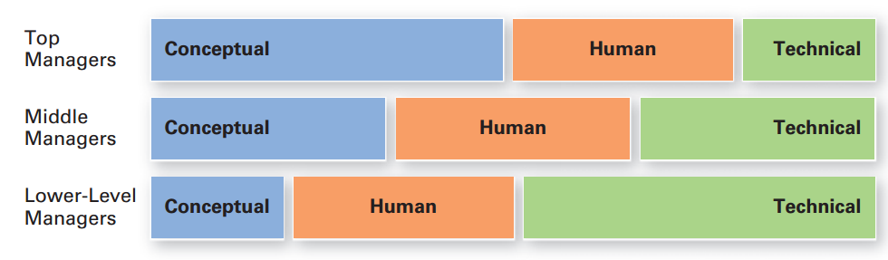
Managerial Roles and Skills
Skills Needed at Different Management Levels

Slide 21
Managerial Roles and Skills
Skills Approach
Technical Skills
Knowledge and proficiency in a specific field
Human Skills
The ability to work well with other people
Conceptual Skills
The ability to think and conceptualize about abstract and complex situations concerning the organization

Slide 22
Operations Management
 Operations is that part of a business organization that is responsible for producing goods and/ or services.
 Goods are physical items that include raw materials, parts, subassemblies such as motherboards that go into computers, and final products such as cell phones and automobiles.
 Services are activities that provide some combination of time, location, form, or psychological value.

Slide 23
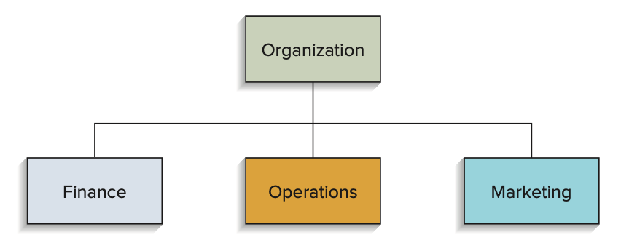
Operations Management
 While the operations function is responsible for producing products and/or delivering services, it needs the support and input from other areas of the organization.
 Business organizations have three basic functional areas, as shown below:
 It doesn’t matter whether the business is a retail store, a hospital, a manufacturing firm, a car wash, or some other type of business; all business organizations have these three basic functions.

Slide 24
Operations Management
 Finance is responsible for securing financial resources at favorable prices and allocating those resources throughout the organization, as well as budgeting, analyzing investment proposals, and providing funds for operations.
 Marketing is responsible for assessing consumer wants and needs, and selling and promoting the organization’s goods or services.
 Operations is responsible for producing the goods or providing the services offered by the organization.

Slide 25
Operations Management
 To put this into perspective, if a business organization were a car, operations would be its engine.
 And just as the engine is the core of what a car does, in a business organization, operations is the core of what the organization does.
 Operations management is responsible for managing that core.
 Hence operations management is the management of systems or processes that create goods and/or provide services.

Slide 26
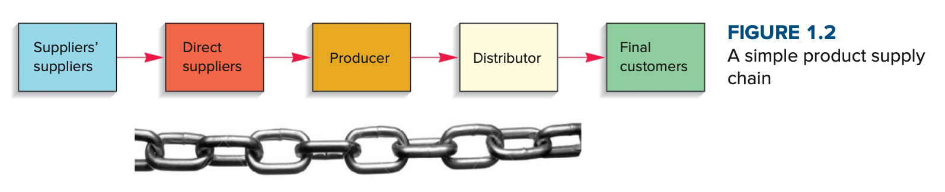
Operations Management
 Operations and supply chains are intrinsically linked, and no business organization could exist without both.
 A supply chain is the sequence of organizations - their facilities, functions, and activities that are involved in producing and delivering a product or service.
 The sequence begins with basic suppliers of raw materials and extends all the way to the final customer.

Slide 27
Operations Management
Facilities might include warehouses, factories, processing centers, offices, distribution centers, and retail outlets.
Functions and activities include forecasting, purchasing, inventory management, information management, quality assurance, scheduling, production, distribution, delivery, and customer service.

Slide 28
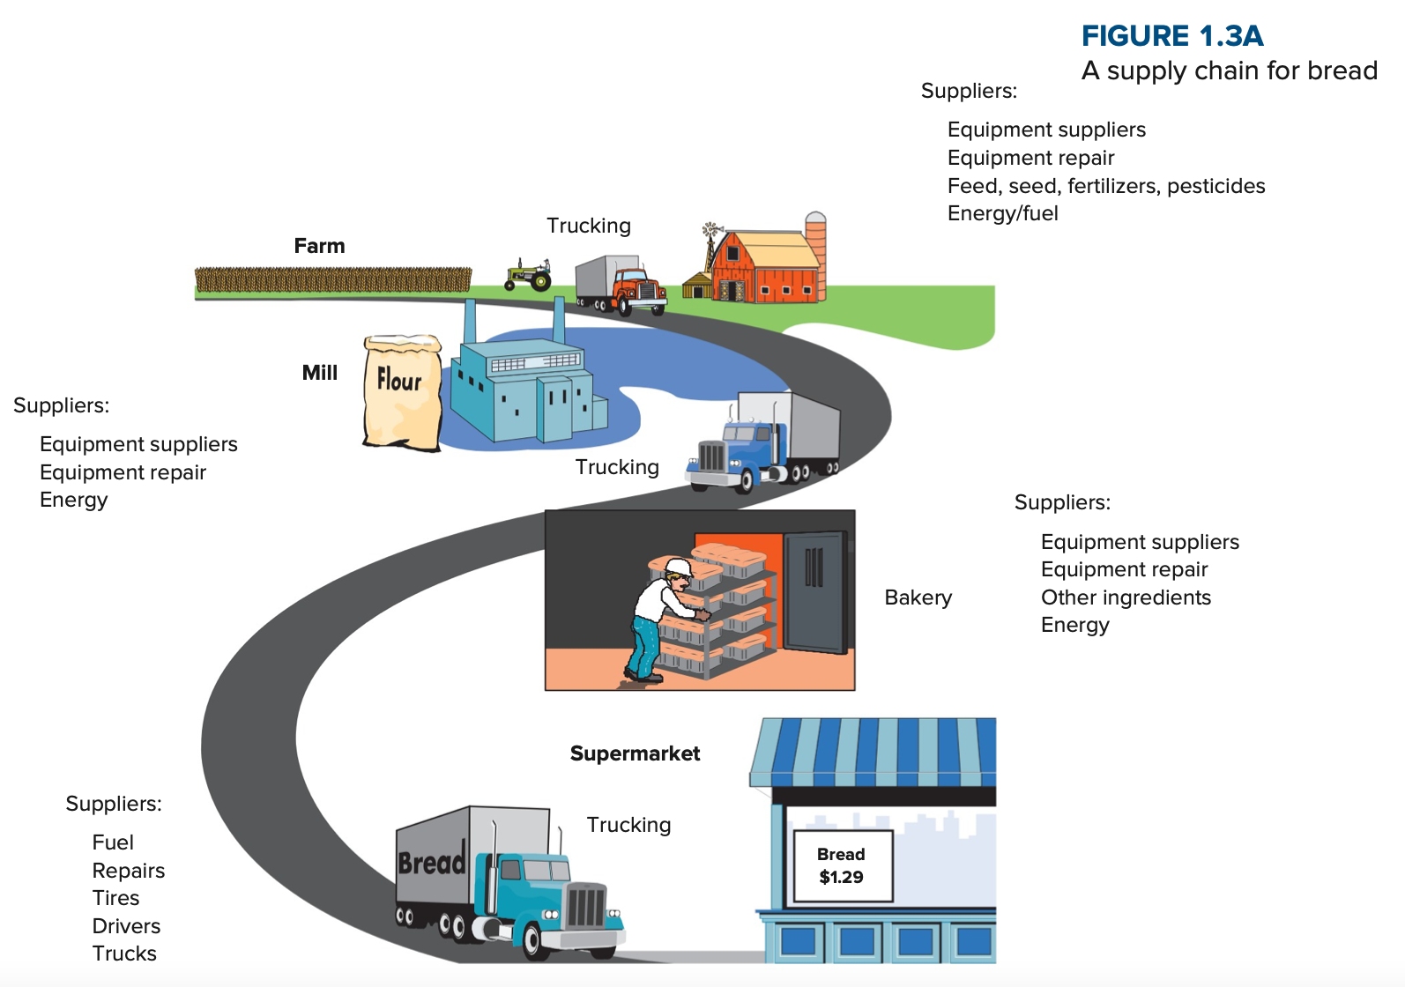
Operations Management
The diagram provides another illustration of a supply chain: a chain that extends from wheat growing on a farm and ends with a customer buying a loaf of bread in a supermarket.
The value of the product increases as it moves through the supply chain.

Slide 29
Operations Management
Value-added is the term used to describe the difference between the cost of inputs and the value or price of outputs.
In nonprofit organizations, the value of outputs (e.g., highway construction, police and fire protection) is their value to society; the greater the value-added, the greater the effectiveness of these operations.
In for-profit organizations, the value of outputs is measured by the prices that customers are willing to pay for those goods or services.
Firms use the money generated by value-added for research and development, investment in new facilities and equipment, worker salaries, and profits.
Consequently, the greater the value- added, the greater the amount of funds available for these purposes. Value can also be psycho- logical, as in branding.

Slide 30
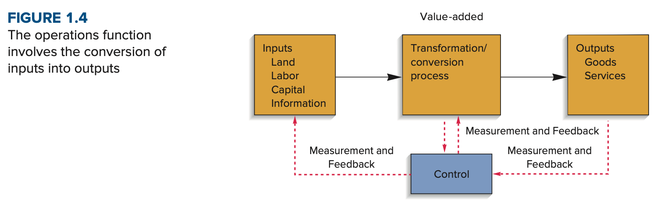
Operations Management

Slide 31
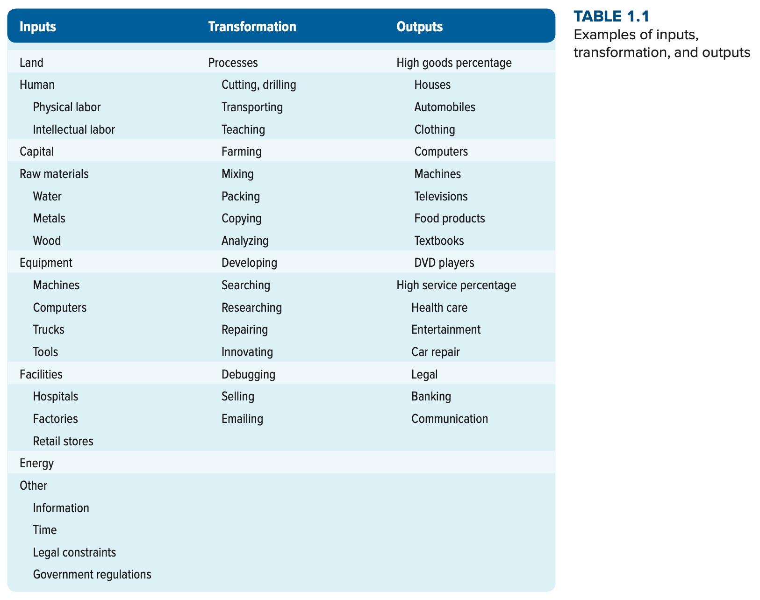
Operations Management

Slide 32
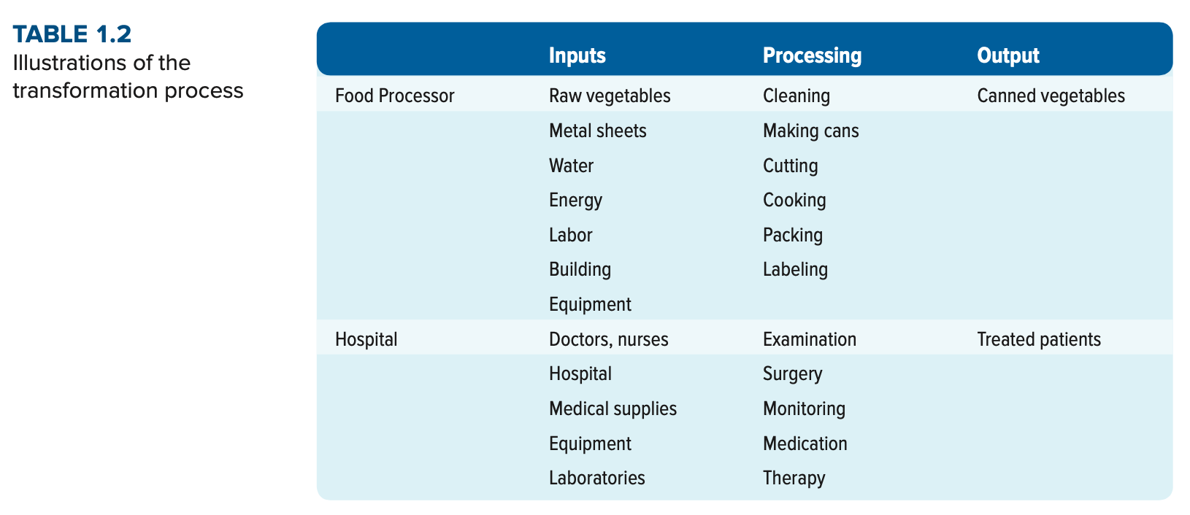
Operations Management

Slide 33
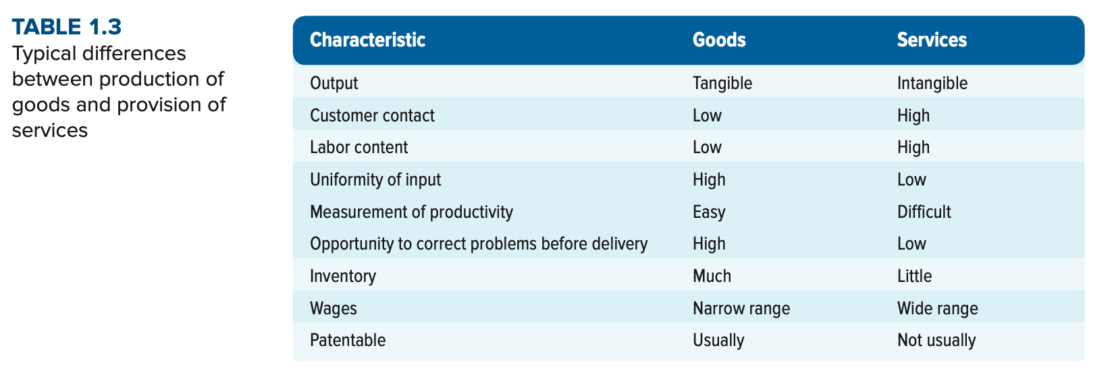
Operations Management

Slide 34
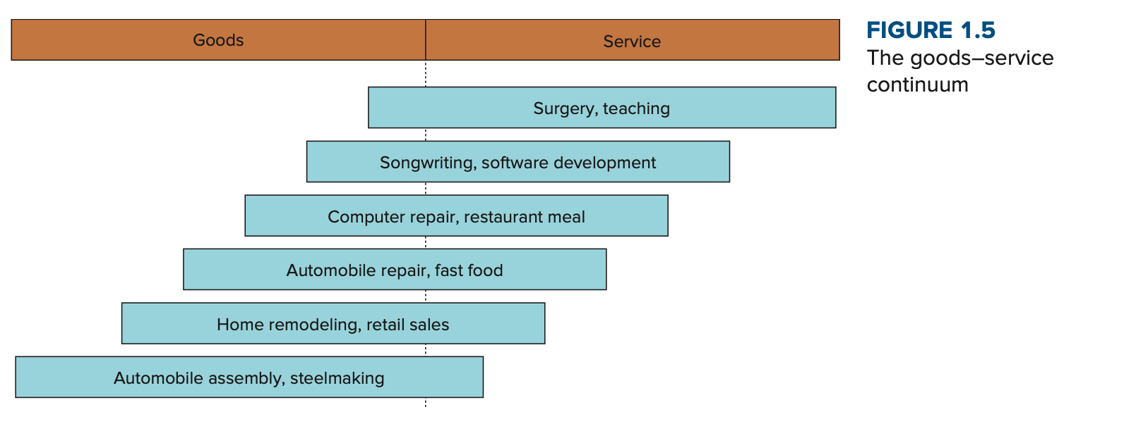
Operations Management

Slide 35
Scopes of Operations Management
Operations Management includes:
Forecasting
Capacity planning
Scheduling
Managing inventories
Assuring quality
Motivating employees
Deciding where to locate facilities
Supply Chain Management (SCM)
And more . . .

Slide 36
Operations Interfaces
Industrial Engineering
Distribution
Maintenance
Purchasing
Operations
Public Relations
Legal
Personnel
Accounting
MIS

Slide 37
END OF THE CHAPTER

